Slide 1
The CDC 8512 Microprocessor
Dr. Charles R. Severance
online.dr-chuck.com

Slide 2
Outline
Our two-instruction "CPU"
What is missing?
Why not study a real CPU?
The CDC8512 – inspired by the CDC 6500

Slide 3


What
Next?
Generic
Computer
Software
Input
and Output
Devices
Central
Processing
Unit
Secondary
Memory
01001001
00111001
Main
Memory
Python for Everybody
Chapter 1
Slide 19
Machine
Language

Slide 4
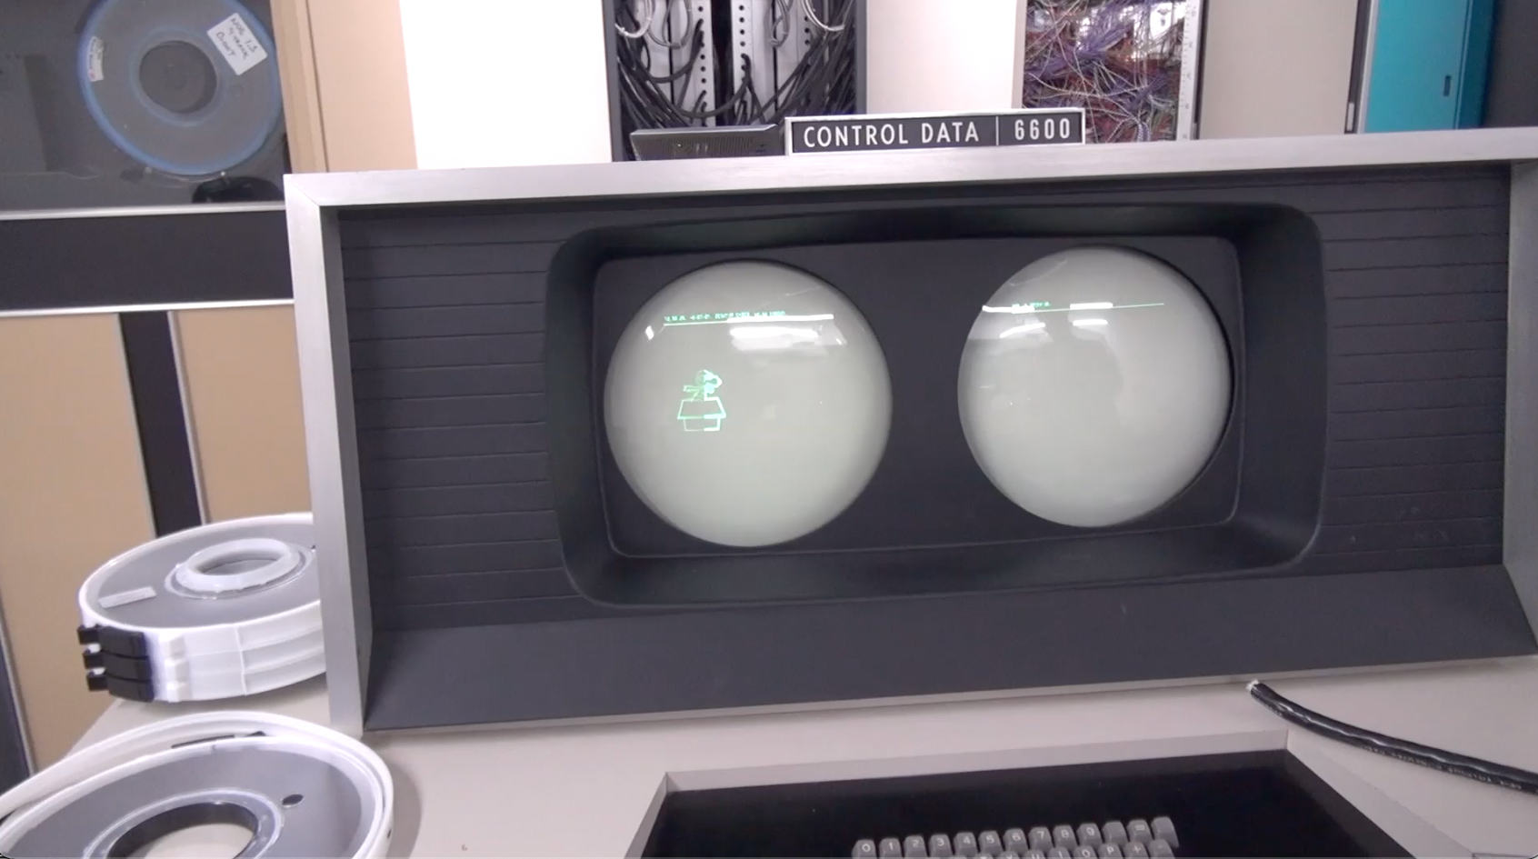
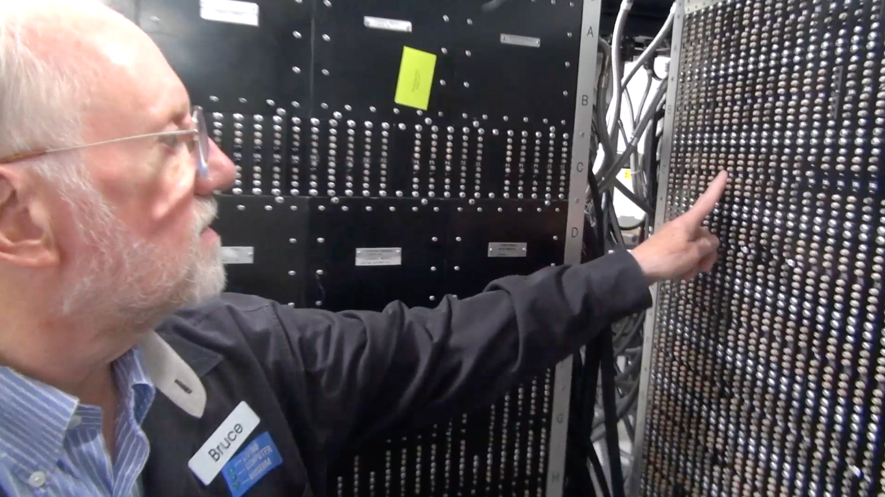
CDC 8512 - Inspired by CDC 6500
Control Data Corporation
Mid 1960’s – mid-1970’s
Dr. Chuck’s first computer
FORTRAN
Assembly Language
https://en.wikipedia.org/wiki/CDC_6000_series#Central_processor

Slide 5
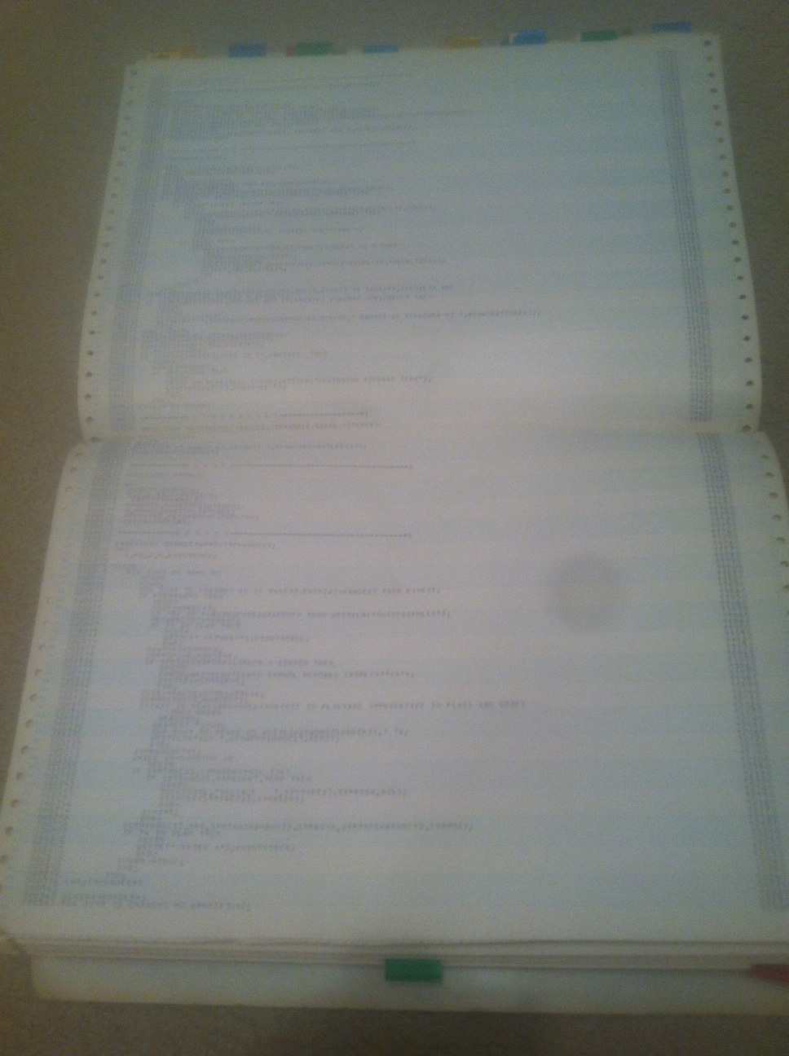
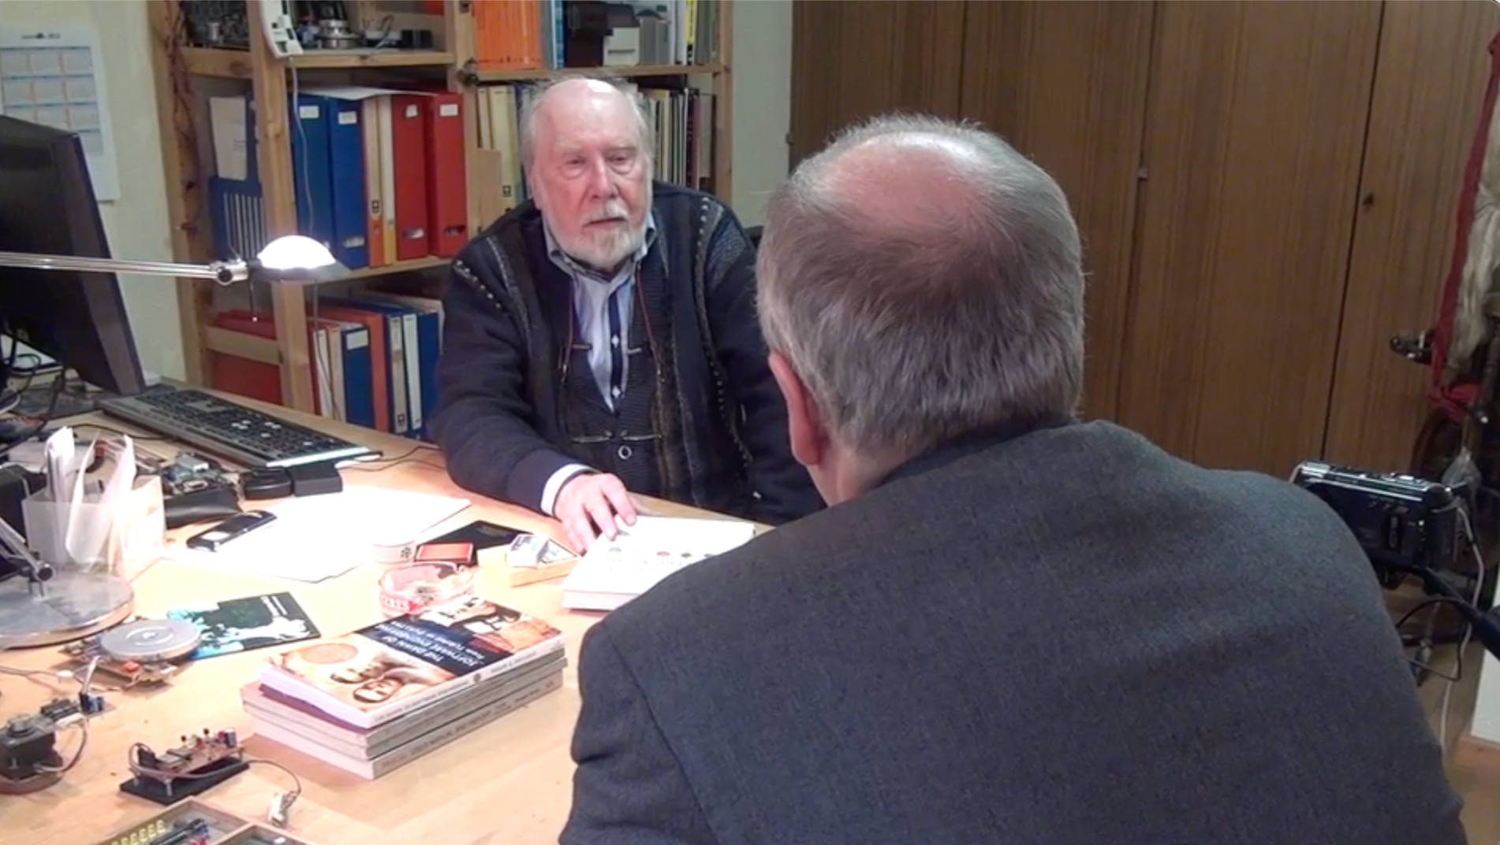
CDC 8512 - Inspired by CDC 6500
Control Data Corporation
Mid 1960’s – mid-1970’s
Dr. Chuck’s first computer
FORTRAN
Assembly Language
Pascal
https://en.wikipedia.org/wiki/CDC_6000_series#Central_processor

Slide 6
About the CDC6500
60 bit words – Integer and floating point formats
6 bit characters - upper case only
Two kinds of data registers - A0-A7 – Address and X0-X7 Operands
To load from memory you put the address in A1-A5 and the data from memory is loaded into the corresponding X1-X5
To store into memory you put the data in X6 or X7 and Set the corresponding A6 or A7 to the location where you want the memory stored

Slide 7
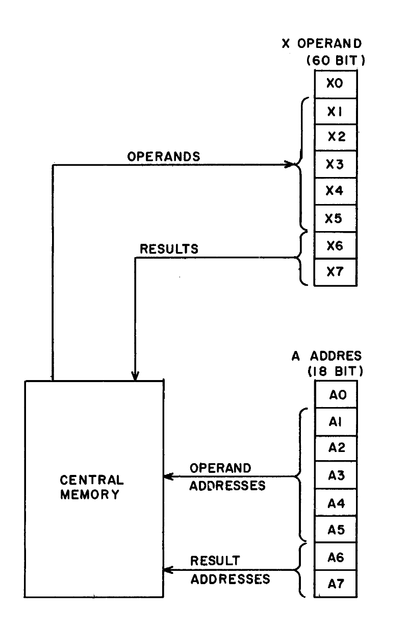
To provide a more compact symbolic language, the 24 operating registers are identified by letters and numbers:
A = Address Register (A0, A1 .. A7)
B = increment register (B0, B1 … B7)
X = operand register (X0, X1 … X7)
The operand registers hold operands and results for servicing the functional units. Five registers (X1-X5) hold read operands from Central Memory and two registers X6 – X7) hold results to be sent to Central Memory (Figure 3-2).
Operands and results transfer between memory and these registers as a result of placing a quantity into a corresponding address register (A1-A7).
-- Control Data 6400/6500/6660 Computer Systems Reference Manual
Figure 3.2
http://ygdes.com/CDC/60100000D_6600refMan_Feb67.pdf

Slide 8
About the CDC8512
8 bit words – Positive integers only (i.e. like a C char)
8 bit characters – ASCII (i.e. like a C char)
256 bytes of Instruction memory and 256 bytes of Data memory
Eight 8-bit registers (A0-A3) and (X0-X3)
When A0 is set it causes a load from Data[A0] into X0 to happen
When A1 is set it causes a load from Data[A1] into X1 to happen
When A2 is set it causes a store from X2 into Data[A2] to happen
When A3 is set it causes a store from X3 into Data[A3] to happen

Slide 9
CDC8512 Architecture
Central Processing Unit
Instruction Memory
Data Memory
PC
255
CM
<=>
0x00
255
0x00
255
A0
255
255
0x01
255
0x01
255
X0
Load
Registers
A1
255
X1
255
0x02
255
0x02
255
0x03
255
0x03
255
A2
255
X2
255
Store
Registers
0x04
255
0x04
255
A3
255
X3
255
0x05
255
0x05
255
…
…
0xFD
255
0xFD
255
0xFE
255
0xFE
255
0xFF
255
0xFF
255

Slide 10
CDC 8512 – Instruction Set

Slide 11
Set a Register
SX3 'C' # Set X3 to the value for ASCII C (67)
SA3 0 # Set A3 to zero and store 'C' in data memory location 0x00
SA1 0 # Set A1 to zero and load memory location 0x00 into X0
SX3 X1 # Copy X3 to X1
SA3 0x01 # Set A3 to 1 and store 'C' in data memory location 0x01
SX3 0x00 # Set X3 to zero
SA3 0x02 # Set A3 to 0x02 and store X3 into location 0x02
# Note constants can be decimal (0-255) hexadecimal (0x00-0xff) or a single
# ASCII character in single quotes 'a'

Slide 12
Register Arithmetic
SX3 'H' # Set X3 to the value for ASCII H
SA3 0 # Set A3 to zero and store 'H' in data memory location 0x00
SX3 'e' # Set X3 to 'e'
INC A3 # Add 1 to A3 and store 'e' in location 0x01
SX3 'l' # Set X3 to 'l'
ADD A3, 1 # Add 1 to A3 and store 'l' in location 0x01
INC A3 # Add 1 to A3 and store 'l' in location 0x02
ADD X3, 4 # Add 3 to X3 so that it is now 'p'
DEC X3 # Subtract 1 from X3 so that it is now 'o'
INC A3 # Add 1 to A3 and store '0' in location 0x03
SX3 0 # Set X3 to integer zero
INC A3 # Add 1 to A3 and store integer 0 in location 0x04
PS 0 # Print memory starting at data address 0 as an
# ASCII string, stopping when a zero is encountered
#
# This will print: Hello

Slide 13
Comparison and Jumps
JP 0x12 # Set the PC (Program Counter) to an instruction address and
# continue execution at that address
CMP X3, 42 # Compare a register to a constant and set comparison status
JE 0x12 # Jump to the instruction address if comparison status is =
JG 0x12 # Jump to the instruction address if comparison status is >
JL 0x12 # Jump to the instruction address if comparison status is <

Slide 14
Miscellaneous Instructions
PS # Print data area starting at specified data address
# stopping when an integer 0 byte is encountered
DI # Dump Instruction area in hex 16 bytes per line
# stop after two successive zeros are encountered in an output line
DD # Dump Data area in hex 16 bytes per line
# stop after two successive zeros are encountered in an output line
HALT # Stop Execution

Slide 15
Summary
SX3 A3 # Copy a register to another
SX3 42 # Set a register to an 8-bit
INC A1 # Add 1 to a register
DEC X3 # Subtract 1 from a register
ADD X1, 42 # Add a constant to a register
SUB X3, 42 # Subtract a constant from a register
JP 0x12 # Jump to a label
CMP X3, 42 # Compare a register to a constant and set comparison status
JE 0x12 # Jump to the label if CMP was equal
JG 0x12 # Jump to the label if CMP was >
JL 0x12 # Jump to the label if CMP was <
PS # Print data area as character string
DI # Dump Instruction area in hex 16 per line
DD # Dump data area in hex 16 per
HALT # Stop Execution

Slide 16
CDC 8512 – Machine Language
(a.k.a. the zeros and ones of programming)

Slide 17
Halt Instruction
HALT # Stop the CPU
0
0
0
0
0
0
0
0

Slide 18
Single Register 8-bit Instruction
INC A2 # Add 1 to A2
Increment Register
Register
0
1
0
0
1
0
1
0
Register
Number
0 = A register
1 = X register

Slide 19
Single Register 8-Bit Instruction
DEC X2 # Decrement X2
Decrement Register
Register
0
1
0
1
0
1
1
0
Register
Number
0 = A register
1 = X register

Slide 20
Set Register to Constant (2 byte instruction)
SX0 0x43 # Set X0
SX0 67 # Set X0
SX0 'C' # Set X0
1
0
0
0
1
1
0
0
0x43
Register
Number
0 = A register
1 = X register

Slide 21
Two Register Instruction
Register
Copy
Source
Register
Destination
Register
SX3 A1 # Copy A1 to X3
1
1
0
0
1
1
1
1
0 = A register
1 = X register
Register
Number
Register
Number
0 = A register
1 = X register

